Slide 1
Laurea University of Applied Sciences
R0279-3002 Information Management and Databases
01.03.2021
MYSQL – Relational Databases:
Project assignment
Anna Mayneva

Slide 2
Quick Response APP
Target customers
Corporate clients, small and medium –sized companies having a need to internally manage the provision, processing and delivery of IT services.
Purpose
Provision of a centralized resource to address questions, troubleshoot IT problems and facilitate solutions to known IT problem. The tool should facilitate the conversion of all the incoming requests from various sources into tickets and track the issue resolution lifecycle.
Goals and objectives
Provide IT services conveniently, quickly and effectively
Improve the end user experience

Slide 3
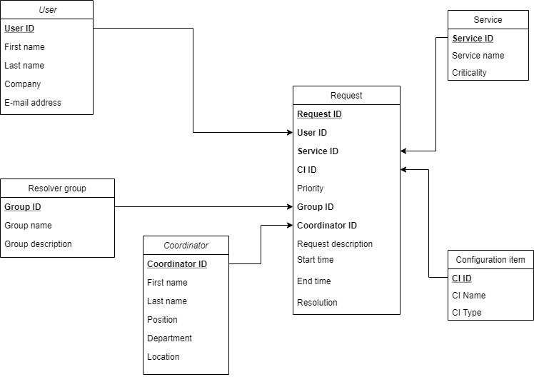
Quick Response APP
The logical structure of DB with primary keys and foreign keys

Slide 4
Quick Response APP
Request cycle:
1. User creates request
2. Coordinator receives request
3. Coordinator chooses the solving group
4. Coordinator changes the default priority, if it is needed
5. The resolver group chooses the configuration item’s name
6. The resolver group solves the problem
7. Coordinator closes the request
This application helps to upload reports that will help to improve the work of the help desk and the second line (system administrators).
Assess the workload of coordinators and working groups
Calculate the time to solve each problem
Find the top systems by which users most often have difficulties
Prioritize requests by criticality
Find the required request not only by ID, but also by other parameters: user, system, description, solution, etc.

Slide 5








Quick Response APP
Example of USER INTERFACE
Request | History | FAQs | Messages | Profile
Request ID
15
User name
Service name
CI Name
Priority
Start time
2021-01-04 15:20
End Time
2021-02-05 17:40
Request description
Attachments
Resolution

Slide 6
Quick Response APP
Example of COORDINATOR INTERFACE
Request ID
18
Username
User email
Service name
CI name
Priority
Coordinator name
Group name
Request description
Attachments
Start time
2021-01-04 12:45
End Time
2021-02-05 09:01
Resolution

